Slide 1
Safe neighborhood
A visualization of crime vs home values in the Dallas county
Gael, Lori, Sisay, Sujita, Van
June 21, 2019

Slide 2
Agenda
Introduction
Data Sources
Data used
Technology used
Limitation of data

Slide 3
Introduction
Create a map of crime in Dallas county.
Layer a map of median household income.
Explore if there is any relationship between median household
Income, home values and number of crimes.

Slide 4
Methodology
API calls to collect data.
Jupiter notebook to manipulate data.
MongoDB and plotly.js for website rendering.
Git Hub as a repository to store analysis and reports.

Slide 5
Resources
Zillow.com
City-data.com
Dallasopendata.com
Geocode.io

Slide 6
Limitations of data
Finding latitude and longitude.
Cleaning up street addresses.
Obtaining dataset for the same year.
Converting XML data to json for Zillow data.
Using 10 cities in Dallas County.
Change data sources several times due to issues with finding what we needed .
Using different browsers.

Slide 7
What could we change?
Add all the indexes.
Present in one file.
Add additional details to the crime chart.
.

Slide 8
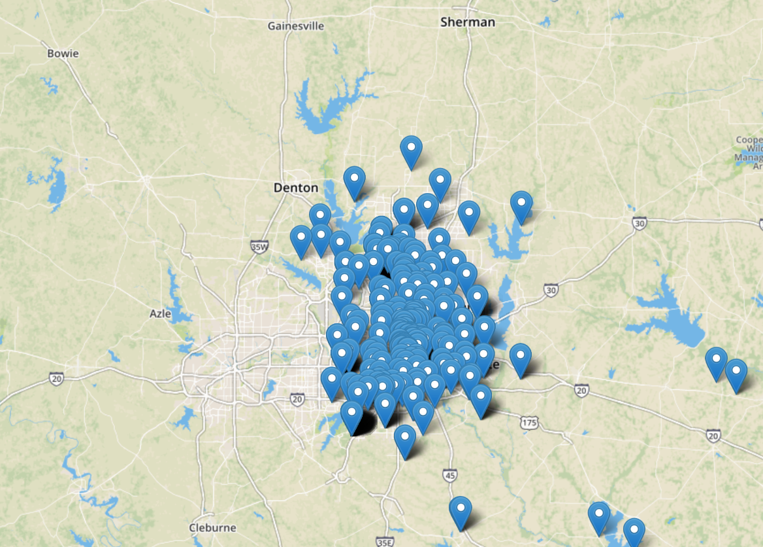
Concentration of crime

Slide 9
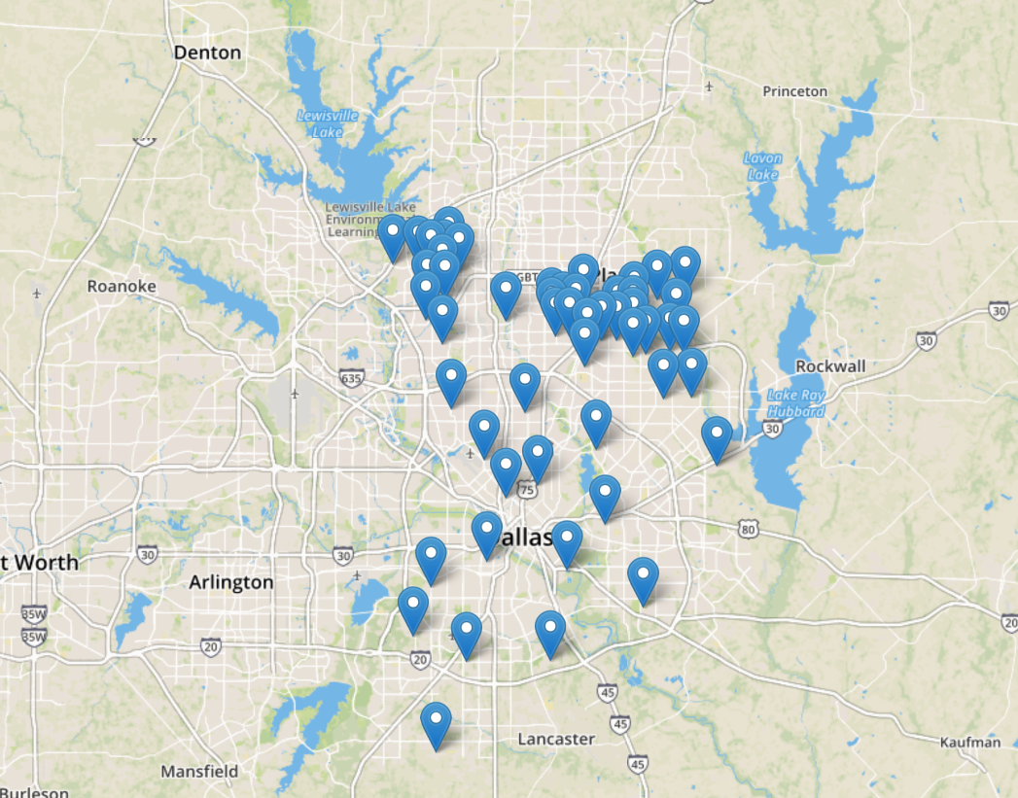
Home values

